Slide 1
Forecast-Based Anomaly Detection with CESNET-TimeSeries24

Slide 2
Problem Setup: Forecast-Based Anomaly Detection in Network Traffic
Motivation:
  Detecting anomalies like DDoS attacks, outages, or data drops is crucial to maintain network health.
  In real systems, Labeled anomalies are rare. Traditional supervised detection is impractical.
Approach:
  Use a forecasting model (SARIMA) to learn normal traffic patterns.
  Detect Anomalies by comparing predictions with actual values (residual based)
Findings:
CESNET-TimeSeries24-40 weeks of IP data
One-shot 7-day vs. 2-day SARIMA forecasts
Rolling forecast strategy (5-week simulation)
Residual-based anomaly detection using:
      3σ rule
      MAD threshold
      Quantile outliers

Slide 3
Dataset Overview
Real-world ISP backbone traffic from the CESNET3 Network
Duration: 40 weeks (Oct 2023 – July 2024)
Covers ~275,000 IP addresses
Time-series on individual IPs, institutional and institutional subnet levels
Data aggregated at 10-min, 1-hour, and 1-day intervals
Total volume: ~66 billion flows (~3.7 PB)
Includes known anomalies:
  DoS attacks
  Scanning behavior
  Monitoring probe outages
Strong weekly cycles (higher on weekdays, lower on weekends)
Koumar, J., Hynek, K., Čejka, T. et al. CESNET-TimeSeries24: Time Series Dataset for Network Traffic Anomaly Detection and Forecasting. Sci Data 12, 338 (2025). https://doi.org/10.1038/s41597-025-04603-x

Slide 4
Methodology: Step-by-Step Approach
Data Selection and Pre-processing
Exploratory Analysis
Model Selection
Parameter Tuning

Slide 5
Methodology: Step-by-Step Approach
Implementation
Forecast and Validation
Performance Evaluation
Anomaly Detection

Slide 6
Software Engineering & Design Decisions
Tools & Libraries:
Tools/Libraries | Functionalities
Jupyter Notebook | Interactive, modular workflow
Pandas | Data Handling
Statsmodels’ SARIMAX | Time-series modeling
MATPlotlib | Visualization
Scikit-learn | Evaluation Metrics
Development Practices: Emphasized clean, modular notebook design – separate sections for data preprocessing, model training, forecasting, and anomaly detection. Code is organized into reusable functions (for metrics, plotting, thresholding) to ensure clarity and ease of maintenance. Visualizations are carefully formatted with clear labels and legends, aiding quick insight into results.
Notes:
We adopted a Seasonal ARIMA model to leverage its built-in handling of trends and weekly seasonality. Following dataset hints, we used SARIMA with order (1,1,1) and seasonal order (1,1,1, 168 hours) – capturing weekly periodicity (24h * 7). This choice was guided by domain knowledge (network traffic follows weekly cycles) and the model’s interpretability.

Slide 7
Software Engineering & Design Decisions
Model Choice (SARIMA):
Model Parameters | Purpose | Pros | Cons
(1,1,1)(1,1,0,168) | Weekly seasonal model | Captures trend+ weekly patterns Avoids seasonal MA (less memory) | Slightly longer training time Higher memory usage
(1,0,0)(0,1,0,168) | Lightweight seasonal baseline | Very fast training Low memory usage Simple and interpretable | Misses short-term correctness
(1,1,1)(1,1,1,168) | Full seasonal model (paper’s baseline) | Strong to fit trend + weekly cycle | High memory usage Can trigger memory error on large datasets

Slide 8
Software Engineering & Design Decisions
We evaluated SARIMA forecasts using both one-shot and rolling strategies:
One-shot Forecasts | Rolling Forecast
Both cases used lighter SARIMA(1, 0,0)(0,1,0) 7-Day forecast (168 hours) Trained SARIMA once on 31days window and forecasted the next 7 days. 2-Day forecast (48 hours) Forecasted the next 2 days. | Implemented only for SARIMA (1,0,0)(0,1,0,168) over the last 5 weeks. Train on previous 31 Days Forecast for next 7 Days Slide window forward weekly
One-shot forecast with Deeper Seasonality
Used SARIMA(1,1,1)(1,1,0,168) with a 21 days training window

Slide 9
Design Challenges Faced
Challenge | Solution
Model Generalization | SARIMA is sensitive to overfitting on recent data. Used fixed retrain windows (21-31 Days) to avoid overfitting; tested 7d vs 2d.
Memory Constraints | CESNET dataset contains 66B+ flows, too large for full in-memory analysis Solution: Filtered to one IP, used pandas efficient filtering + indexing only to required columns
Index Misalignment Issues | Misaligned residuals let to false anomaly detection. Ensured forecast index = test index and used pandas DataTimeIndex throughout.
Notes:
Initially, we encountered misalignment between forecasted values and actual observations when computing residuals. This often arose from off-by-one indexing (e.g., the forecast starting one hour after the last training point). The result was residuals that didn’t match the correct timestamps, confusing the anomaly detection. We resolved this by carefully aligning prediction output indices with the actual time index – ensuring that each forecast value is paired with the correct actual timestamp. By using pandas DateTimeIndex consistently for both actuals and predictions, we eliminated the index offset and ensured residuals were correctly computed for each time slot. The dataset contains gaps (hours with no recorded flows), which initially caused errors in model fitting and evaluation (the time series was not strictly continuous in time). We addressed this by re-indexing the time series to a continuous hourly timeline, filling missing hours with zero flows or carrying forward nearest values as appropriate. Handling these missing timestamps was crucial to avoid skewing the seasonal pattern and to prevent the SARIMA model from misinterpreting gaps as irregular intervals. Additionally, we verified time zone and timestamp consistency (ensuring all data was in UTC) to avoid any subtle alignment issues. Once the datetime index was clean and continuous, the SARIMA model could be trained and evaluated without indexing errors.

Slide 10
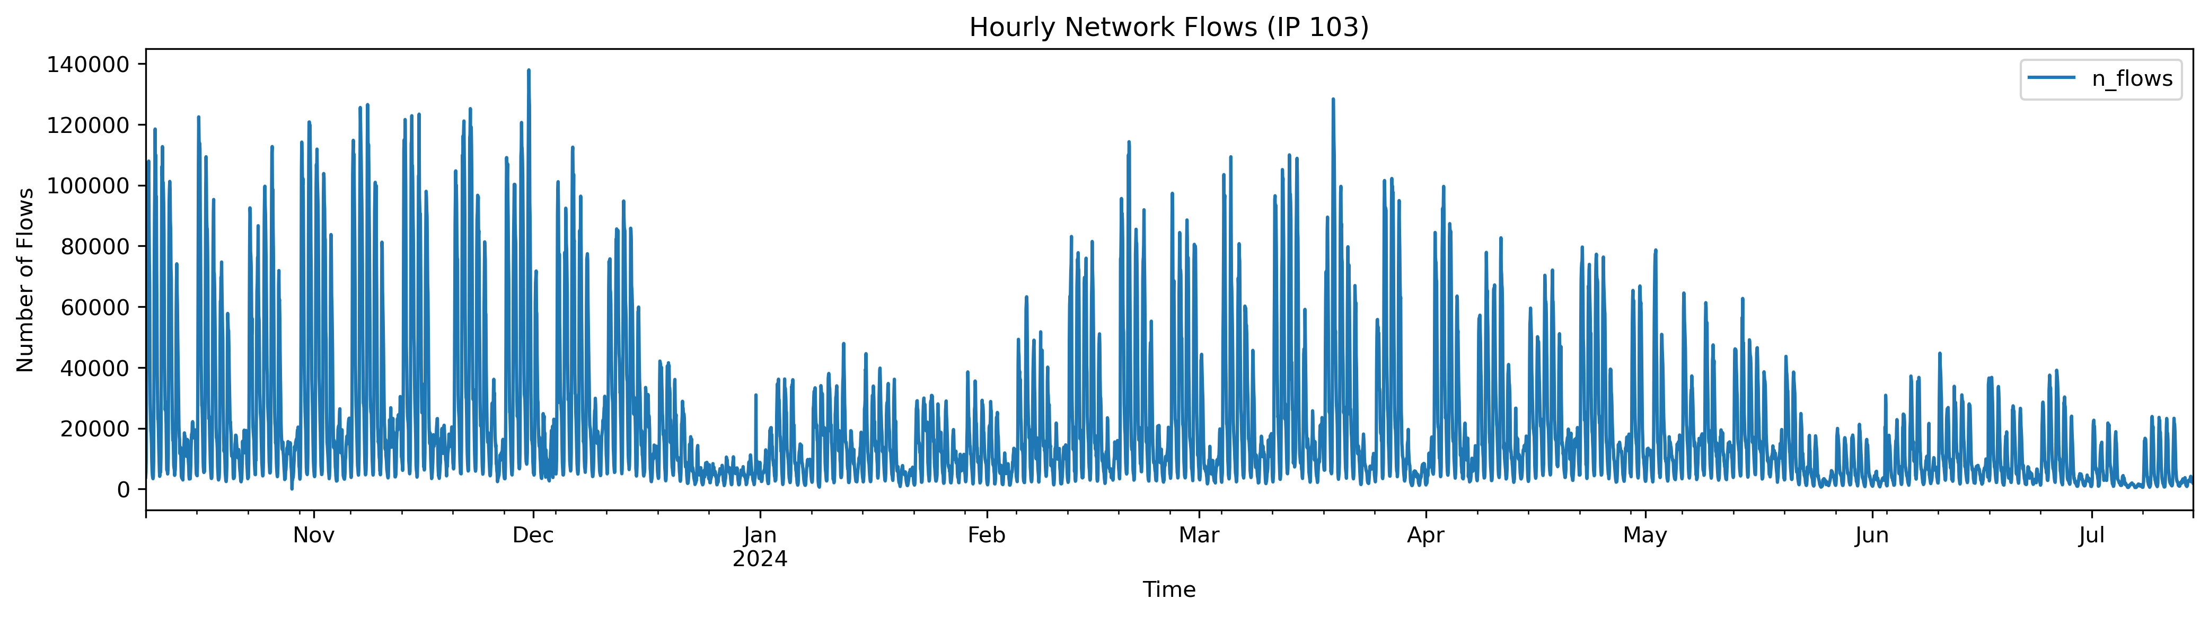
Results and Interpretation
Count: 6,718
Mean: 21,358
Std: 24,879
Min: 0
25%: 5,198
50%: 11,943
75%: 25,610
Max: 137,970 (major traffic spike)
Strong weekly cycles (higher on weekdays, lower on weekends
Distribution is right-skewed: the mean is nearly double the median, indicating the presence of large traffic spikes
The max flow count is over 6× the mean, suggesting a potential anomaly or DoS event
High variance confirms bursty, irregular network behavior
This clear structure and occasional extremes make the series suitable for SARIMA modeling with seasonal components

Slide 11
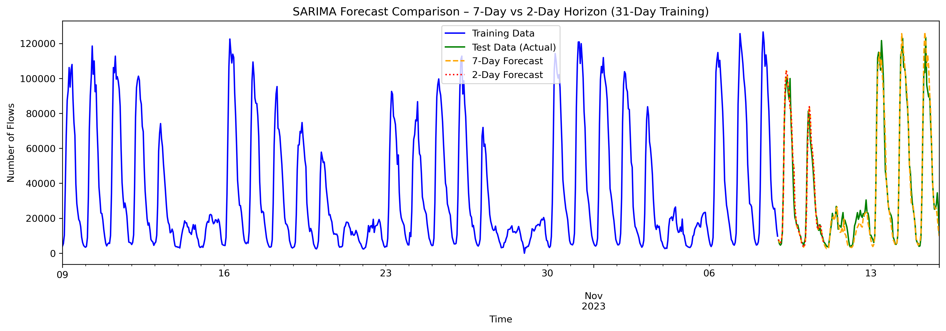
SARIMA Forecast Comparison: 7-Day vs 2-Day Horizon
SARIMA Forecast Comparison: 7-Day vs 2-Day Horizon SARIMA(1,0,0)(0,1,0,168) :
Compares one-shot forecasts for 7-day (orange dashed) and 2-day (red dotted) horizons
Forecasts follow a 31-day training window
Both track general trends well; 2-day model adapts better to local fluctuations

Slide 12
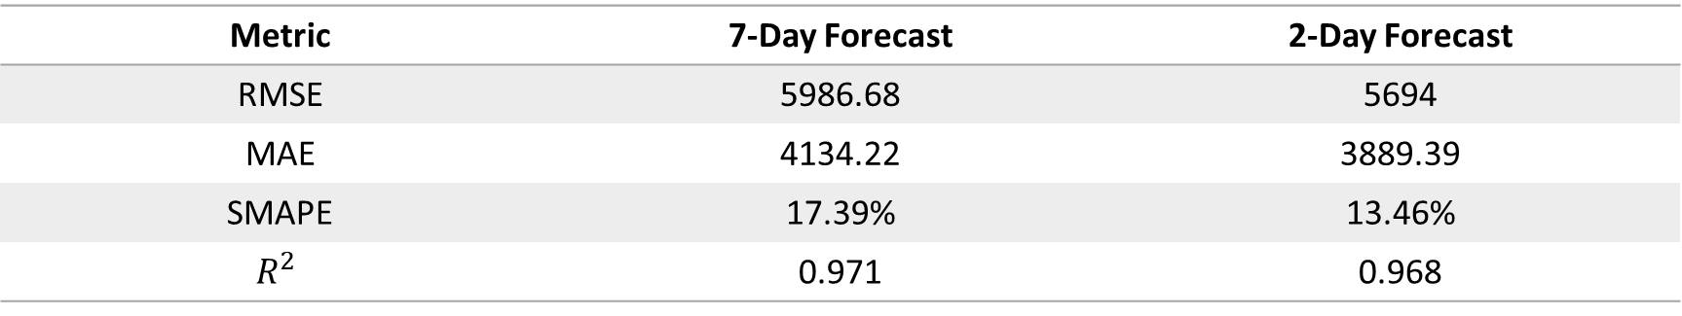
SARIMA Forecast Comparison: 7-Day vs 2-Day
Metric | 7-Day Forecast | 2-Day Forecast
RMSE | 5986.68 | 5694
MAE | 4134.22 | 3889.39
SMAPE | 17.39% | 13.46%
$$R^{2}$$ | 0.971 | 0.968
Key Takeaways:
Both models explain >96% of variance
2-day forecast shows lower error across all metrics
Frequent retraining improves short-term accuracy
Shorter horizon → better anomaly detection reliability

Slide 13
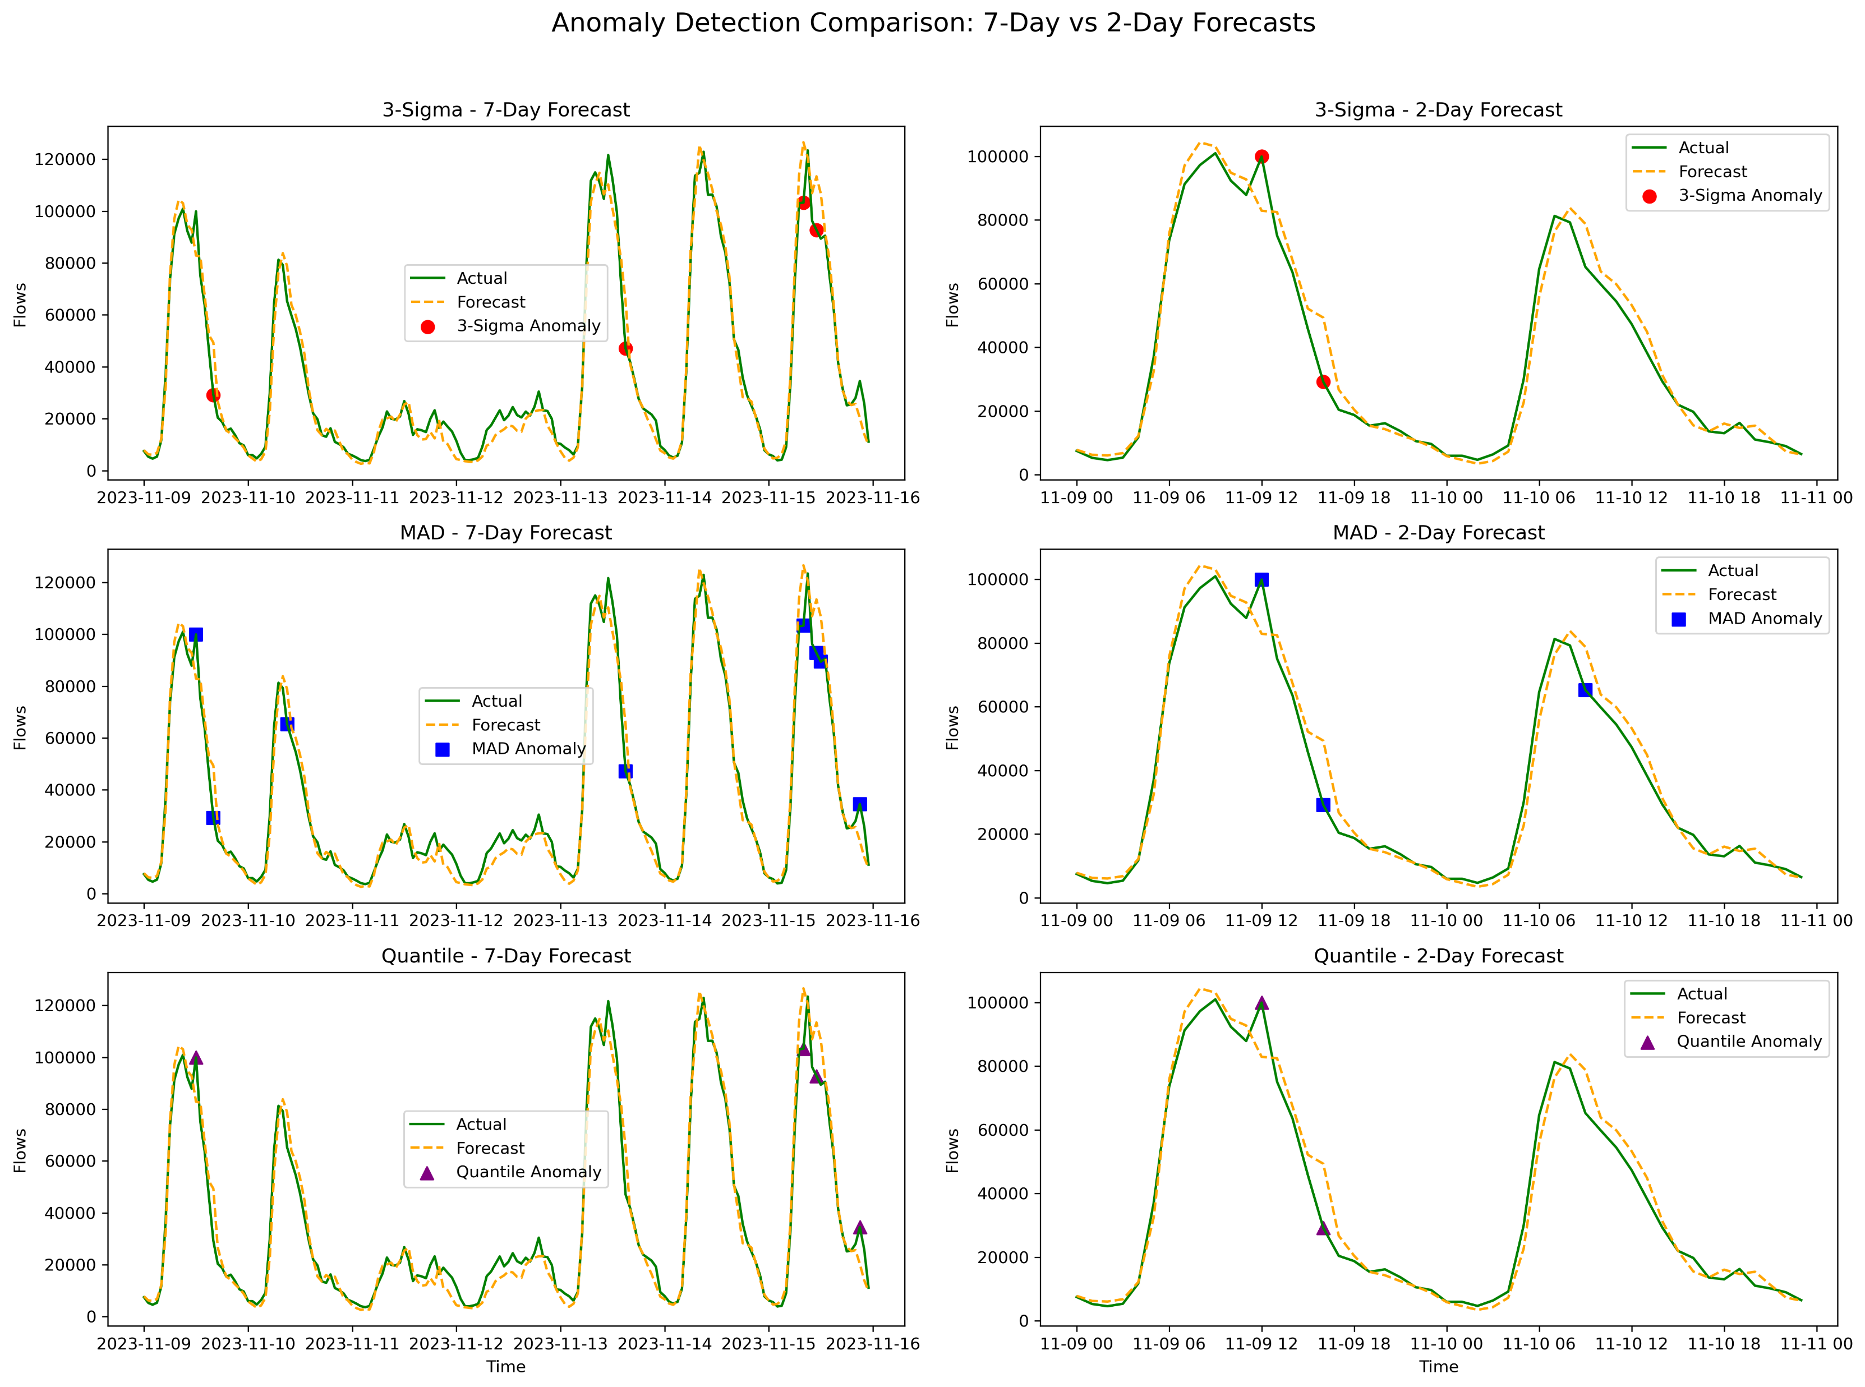
SARIMA Forecast Comparison: 7-Day vs 2-Day

Slide 14
SARIMA Forecast Comparison: 7-Day vs 2-Day
Method | 7-Day | 2-Day
3-Sigma | 4 | 2
MAD | 8 | 3
Quantile | 4 | 2
Key takeaways:
3- Sigma = Most conservative
Flags only large, high confidence spikes
Best for major anomaly detection
MAD = More Sensitive
Detects moderate and sharp deviations
Suitable for early warnings and noisy environments
Quantile = Balanced Trade-off
Flags tail-end residuals(e.g. 99th percentile)
Sensitivity is tunable (98%, 95% etc)
2-Day Model generalizes better, fewer anomalies, better aligned with actual traffic changes.

Slide 15
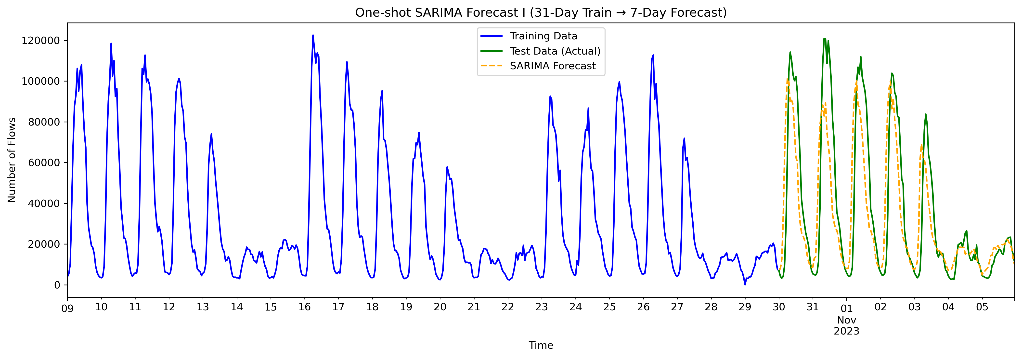
Results and Interpretation
Forecast Evaluation (One-shot SARIMA I 7 Days):
RMSE: 21731.99 flows/hour
MAE: 14592.54 flows/hour
R²: 0.638
SMAPE: 44.63%
Anomalies Detected in Test Period:
• 3-Sigma method : 0 points
• MAD method : 25 points
• Quantile method : 4 points

Slide 16
Results and Interpretation
SARIMA(1, 0, 0)(0, 1, 0, 168)
This configuration simplifies the model by:
Removing AR/MA seasonal terms
Relying on weekly seasonal differencing (D=1, s=168)
Using a shorter, non-differenced core structure (d=0) for faster training and more stability
Major improvement over previous config (RMSE dropped by >15k)
R² ↑ from 0.64 to 0.97 → model explains nearly all variance
SMAPE ↓ from 44.6% to 17.4% → better relative error performance
Config | RMSE | R² | SMAPE
SARIMA(1,1,1)(1,1,1,168) | 21,732 | 0.638 | 44.6%
SARIMA(1,0,0)(0,1,0,168) | 5,987 | 0.971 | 17.4%
Notes:
Why we changed the setting:
The original model over-differenced and over-parameterized the data
Simplifying the model (fewer ARMA terms, no non-seasonal differencing) improved fit and reduced overfitting
Weekly seasonal differencing alone was sufficient to capture recurring patterns

Slide 17
Results and Interpretation
Anomaly Detection Summary Table:
Method 7-Day Anomalies 2-Day Anomalies
3-Sigma 4 2
MAD 8 3
Quantile 4 2
Forecast Evaluation (One-shot SARIMA 7 days):
RMSE: 5986.68 flows/hour
MAE: 4134.22 flows/hour
R²: 0.971
SMAPE: 17.39%
Forecast Evaluation (One-shot SARIMA – 2 Days):
RMSE: 5694.00 flows/hour
MAE: 3889.39 flows/hour
R²: 0.968
SMAPE: 13.46%

Slide 18
Comparison with CESNET-TimeSeries24 Paper

Slide 19
Methodology: Step-by-Step Approach
Data Selection & Preprocessing: Chose the IP flows for address ID 103 with 1-hour intervals. Cleaned and prepared the data by handling any irregularities – e.g. addressed missing values, and ensured stationarity through transformations (differencing to remove trends).
Exploratory Analysis: Performed an initial data exploration to understand patterns and variability. Visualized the time series to identify trends, weekly seasonal cycles, and anomalies. Analyzed statistics (mean, variance) over time and used plots (e.g. time plots) to confirm a strong weekly seasonality and any periodic behaviors in the traffic data.
Model Selection: Decided on a forecasting model suited for the data’s characteristics. Given the observed weekly pattern in network flow counts, selected a Seasonal ARIMA (SARIMA) model to capture both trend and weekly seasonality. (Seasonal period is set to 168 hours ≈ 1 week , aligning with the data’s weekly cycle.) This choice was made to leverage SARIMA’s strength in modeling repeating weekly traffic patterns. Used two settings (1,1,1)(1,1,0,168) and (1,0,0)(0,1,0,168)

Slide 20
Methodology: Step-by-Step Approach
Parameter Tuning: Used ACF/PACF plots and grid search (guided by AIC/BIC) to choose SARIMA orders. Tuned (p,d,q) and seasonal (P,D,Q,m) – initial guess based on domain (daily or weekly cycles) and tested different combinations. For example, evaluated models with and without seasonal terms to see improvement in fit.
Implementation: Leveraged statsmodels’ SARIMAX for modeling, with training data scaled appropriately. Used Python libraries: pandas for data manipulation, numpy for calculations, statsmodels for SARIMA, and sklearn for computing error metrics (RMSE, MAE, R², etc.). Ensured code was modular (separate functions for training, forecasting, and anomaly detection) and efficient (avoiding loops via vectorized operations).
Forecasting & Validation: Performed forecasts with two setups: (a) One-shot forecast – train on an initial period and predict a long horizon (e.g. 7 days) without update; (b) Rolling forecast – re-train or update the model periodically (e.g. every 2 days) and forecast the next interval. Followed the dataset authors’ recommendation to use a sliding window retraining approach for long-term evaluation

Slide 21
Methodology: Step-by-Step Approach
Performance Evaluation: Evaluated forecast accuracy using Root Mean Square Error (RMSE), Mean Absolute Error (MAE), R² (coefficient of determination), and SMAPE (Symmetric Mean Absolute Percentage Error). These metrics were computed for both 7-day and 2-day prediction horizons to compare performance.
Anomaly Detection: Calculated forecast residuals (actual minus forecast). Applied three threshold-based methods on residuals to flag anomalies: (i) 3-sigma rule (points beyond 3 standard deviations from mean), (ii) Median Absolute Deviation (MAD) based threshold, and (iii) Quantile method (e.g. top 1% extreme residuals). Labeled time points as anomalous if their deviation exceeded the chosen threshold. Visualized results with time series plots marking detected anomalies.
Results Interpretation: Analyzed which anomalies were detected by each method and compared against known events or expected behavior (from the CESNET24 paper). Assessed false positives/negatives and refined thresholds if necessary. Summarized key findings and trade-offs for discussion.

Slide 22
Results and Interpretation
Forecast Accuracy (7-day vs 2-day): We evaluated model predictions on two forecast horizons – 7 days and 2 days ahead – to compare performance. Overall, the shorter horizon forecasts were more accurate, as expected. For the 7-day forecast, the model achieved an RMSE ≈ 10,951 and R² ≈ 0.77, while the 2-day forecast improved to RMSE ≈ 10,294 with R² ≈ 0.79.
In other words, retraining every 2 days (instead of forecasting a full week at once) reduced error by roughly 6% and explained a bit more variance in the traffic pattern. The SMAPE (Symmetric Mean Absolute Percentage Error) was around 40.7% for 7-day vs 40.9% for 2-daynature.com – essentially unchanged (a minor increase, indicating the percentage error stayed similar). We also tracked MAE (Mean Absolute Error) in our evaluation; it showed a slight decrease with the shorter horizon (consistent with the RMSE improvement, indicating the average error dropped as well). The comparable SMAPE but improved RMSE/MAE and R² suggest that while overall percentage error remained in the same range, the 2-day model was better at capturing absolute variations in traffic (likely due to more frequent model updates).

Slide 23
Results and Interpretation
Anomaly Detection Outcomes: When actual traffic deviates beyond the expected range, it is flagged as an anomaly. Similarly, in our analysis of IP 103, large positive residuals (actual traffic far exceeding forecast) were flagged by the threshold rules. All three methods (3σ, MAD, and 99th quantile) detected the major spike in traffic, corresponding to a suspected attack or outage event.
3-Sigma Rule: Assuming residuals are roughly normal, any point where |residual| > 3·σ (σ = residual standard deviation) was marked as an anomaly. This method was the most conservative, flagging the fewest anomalies (only the most extreme outliers trigger it). In our results, the 3-sigma threshold raised very few alerts – on the order of ~1 notable spike in the evaluation period – consistent with a ~99.7% confidence interval for “normal” errors.
MAD (Median Absolute Deviation) Threshold: A robust approach using the median and MAD to detect outliers. We marked points where the residual exceeded a certain multiple of the MAD (calibrated to approximate a 3σ equivalent). The MAD-based method proved more sensitive than 3-sigma, identifying slightly more anomalies. Because MAD is less influenced by a few large errors, it adapts to the typical error scale and can catch outliers that might not reach 3σ if the error distribution is heavy-tailed. MAD (Median Absolute Deviation) Threshold: A robust approach using the median and MAD to detect outliers. We marked points where the residual exceeded a certain multiple of the MAD (calibrated to approximate a 3σ equivalent). The MAD-based method proved more sensitive than 3-sigma, identifying slightly more anomalies. Because MAD is less influenced by a few large errors, it adapts to the typical error scale and can catch outliers that might not reach 3σ if the error distribution is heavy-tailed
Quantile Threshold: A non-parametric approach where we chose a high percentile (e.g., 99th percentile of absolute residuals) as the cutoff. Any residual beyond this percentile is considered an anomaly. This method is easy to tune (e.g., choose 98%, 99% depending on desired sensitivity) and does not assume normality. In our case, the 99th percentile threshold yielded a comparable anomaly count to the MAD method (around 2–3 points flagged in the test window). It tended to flag the same large outlier as 3-sigma and one additional point that was borderline. Lowering to 98th percentile would catch more anomalies (potentially too many false alarms), so 99% was a balanced choice for our data.

Slide 24
Trade-offs in Algorithm Selection
Rationale for SARIMA: We chose SARIMA due to its interpretability, simplicity, and suitability for seasonal data. SARIMA models provide explicit parameters for trend (differencing) and seasonality, making it clear how the model is accounting for weekly cycles or growth/decay trends. This interpretability is valuable for explaining results to stakeholders – for instance, we can discuss the autoregressive terms or seasonal indices in meaningful terms (like “each week’s pattern repeats”). Additionally, SARIMA works well if the time series is or can be made stationary, which was reasonable for our data after seasonal differencing. It allowed us to incorporate domain knowledge (weekly seasonality = 168 hour cycle) directly into the model structurenature.com.Alternatives Considered: We weighed using neural network models (e.g., LSTM or Prophet or even tree-based regressors) and ensemble approaches. These can automatically capture complex nonlinear patterns that SARIMA might miss. However, they come at the cost of being black-box models with many parameters and needing more data for training. Given the moderate size of our training set (only ~31 days of hourly data for initial trainingnature.com) and the desire to avoid overfitting, a simpler model was safer. Moreover, in an interview scenario, being able to discuss how the model works was important – SARIMA’s statistical basis is easier to convey than the internals of an LSTM.Accuracy vs Interpretability: We acknowledged that a well-tuned deep learning model or an ensemble might extract subtle patterns (e.g., holiday effects, nonlinear traffic spikes) that a linear model could misseyer.ai. For example, neural networks excel at learning complex, nonlinear relationships and could adapt if the traffic pattern changed in ways SARIMA can’t easily accommodateeyer.ai. If raw predictive accuracy were the sole goal, exploring those methods would be justified. However, our priority was a transparent model whose predictions and anomalies we could trust and explain. SARIMA offers consistent performance on stationary data and high interpretability, whereas neural models, while powerful, might yield higher false positives if they learn spurious patterns, and it’s harder to pinpoint why they flag a particular anomaly.Computational Considerations: Training and tuning SARIMA was relatively fast (on the order of seconds to fit to our data), enabling quick iteration. In contrast, training a neural network could take much longer and complicate the workflow (GPU requirements, hyperparameter tuning, etc.). Since our use-case (and the interview evaluation) valued a sound engineering solution over bleeding-edge complexity, SARIMA was a practical choice. This reflects the classic trade-off between accuracy and complexity – more complex models might improve fit marginally but with diminishing returns and increased maintenance burdeneyer.ai. Our approach favored the “keep it simple” principle, ensuring that the solution is robust, easier to debug, and sufficient for detecting major anomalies.When to Consider Others: We did note that if this were a production system monitoring many IPs or more volatile metrics, we might incorporate additional methods. For example, one could use SARIMA as a baseline and add a machine learning model to analyze residual patterns (a hybrid approach)eyer.ai. Hybrid or ensemble models can sometimes catch anomalies that a single method misseseyer.ai, but as literature suggests, they increase complexity and may be overkill for a single univariate serieseyer.ai. In our case, SARIMA alone proved adequate, reinforcing the idea that algorithm selection should match the problem complexity – and simpler, well-understood models are often preferable for initial implementations or when interpretability is key.

Slide 25
Software Design Choices
Separate Forecast Blocks (7-day vs 2-day): We structured the notebook to handle 7-day and 2-day forecasts in separate blocks/pipelines. This separation was intentional to facilitate comparison. Each block trained its own SARIMA model (or re-used with retraining) and produced forecasts for the specified horizon, followed by error metric calculation. By isolating them, we could clearly observe how model performance changed when predicting 168 hours at once versus 48 hours at a time. The design also made the code easier to follow – one could look at the “7-day forecast” section or the “2-day forecast” section and see all steps for that experiment without confusion. The results (as discussed) showed improved accuracy with shorter retraining intervalsnature.com, validating this design choice. In practice, such separation also mirrors how one might deploy models: e.g., a long-term forecast model for weekly planning and a short-term model for daily anomaly monitoring.Use of Datetime Index: A key design decision was to use a pandas DateTimeIndex for all time series data. Instead of treating the data as generic sequential points, we kept real timestamps. This had multiple benefits: (1) It ensured correct alignment of forecast outputs with actual data by timestamp (preventing the misalignment issues we encountered early on). (2) It allowed easy resampling and interpolation of missing periods. (3) It made plots and analysis more interpretable (x-axis showing actual dates and times). By indexing by datetime, we could also exploit pandas time-based slicing (e.g. easily select the last week of data for testing, or filter specific date ranges). The emphasis on proper indexing is a software-engineering best practice for time series, preventing logical errors when the model’s predictions are integrated back into the dataset. In short, using datetime indices enhanced data integrity and clarity throughout the project.Multiple Anomaly Detection Methods: We implemented three anomaly detection methods (3-Sigma, MAD, Quantile) rather than just one, which was a conscious design choice. This comparative approach provided a robustness check – if all methods flag a particular point, we have high confidence it’s truly anomalous; if only the loosest threshold flags something, it might be a weaker anomaly. Designing the software to easily switch between or combine methods added flexibility. For instance, we created a function to apply a given threshold rule to residuals, so we could reuse it for each method without duplicating code. We also output the list of anomalies from each method side by side for review. This modular design means new methods can be added (say, an IQR-based outlier detection) by plugging into the same interface. The justification for multiple methods also lies in acknowledging uncertainty – different statistical assumptions can yield different results, and by observing all, we made our analysis more comprehensive. For example, the MAD method’s robustness to outlierscrispinagar.github.io complements the assumption-heavy 3-sigma method; implementing both ensured that we didn’t miss anomalies just because the residual distribution wasn’t perfectly normal. Similarly, the quantile method gave a tunable non-parametric option. The software was designed to make these comparisons straightforward, reflecting good engineering (not hard-coding a single threshold, but allowing parameter variation).Reproducibility and Clarity: We made choices to ensure the analysis is reproducible and easy to follow. For instance, we fixed random seeds where applicable (though SARIMA is mostly deterministic), and clearly separated data preparation from model fitting. We logged or printed out configuration (like SARIMA orders, training data range, threshold values used) at the start of each section so that someone reviewing the notebook can immediately see what parameters were in effect. These design considerations are subtle but important for a technical audience – they demonstrate attention to detail and make it easier for reviewers (like an interview panel) to trace what was done without confusion.

Slide 26
Validation Strategy
Forecast Evaluation: We validated the forecasting accuracy using standard time-series evaluation metrics on the held-out periods. Specifically, after generating forecasts for 7 days and 2 days, we compared them against the actual observed values over those intervals, computing RMSE, MAE, R², and SMAPE for each case. This evaluation was done in a time-aligned manner: because we maintained proper datetime indices, each forecast value was matched to the correct timestamp’s actual value (ensuring a fair comparison). By reporting metrics for different forecast lengths, we confirmed that a shorter forecast horizon (with more frequent model updates) yields better performancenature.com, which is a sanity check consistent with expectations. We took care not to train on any part of the test (forecast) interval – the model only saw data prior to the forecast window, mimicking a real scenario where future values are unknown.Visualization & Qualitative Checks: In addition to numerical metrics, we relied on visual inspection of the forecast vs actual plots (like Fig. 10 above) to ensure the model was capturing the general pattern and seasonality. Any large deviations in the plot immediately pointed to either potential anomalies or areas where the model fit could be improved. For instance, we observed that certain weekend drops in traffic were under-predicted by SARIMA, aligning with known challenges in capturing abrupt changes – this qualitative insight was gained by examining the plotted results and informed our anomaly analysis.Residual Analysis for Anomalies: Our anomaly detection had to be validated without explicit ground truth labels (since in unsupervised anomaly detection, true anomalies are often unknown). We approached this by verifying that residual-based anomalies corresponded to visible aberrations in the time series. After applying the 3 methods, we plotted markers on the time series for each flagged anomaly and manually checked them. Each flagged point indeed coincided with a sudden spike or drop outside the normal range, which provided confidence that the methods were working as intended. Furthermore, we compared anomalies across methods: a point flagged by all was almost certainly a true anomaly (e.g., a pronounced traffic surge), whereas points flagged only by the quantile method (and not by 3-sigma) tended to be smaller deviations that, upon inspection, were less concerning. This comparative validation ensured that our choice of thresholds was reasonable.Metrics for Anomaly Detection: While we didn’t have true labels to compute precision/recall, we did measure indirectly the consistency of anomaly flags. For instance, we looked at how many anomalies each method flagged per day and whether these frequencies were plausible (e.g., we wouldn’t expect dozens of anomalies in a short benign period). The counts we observed (low single digits in a week) seemed plausible for a relatively stable IP traffic pattern, suggesting our threshold levels were calibrated to capture only significant outliers. Had a method produced a very high anomaly rate, it would indicate a low precision (many false alarms), prompting a threshold adjustment.Cross-Verification with Domain Knowledge: Finally, we considered whether any flagged anomaly corresponded to known events or typical network issues. In a real deployment, one would cross-verify anomalies with external data (e.g., Did a known DDoS attack happen at that time? Was there a maintenance event?). In our project context, we treated any large residual as a potential “incident.” However, we did note that the dataset includes known attack scenarios identified by expertsnature.com. If our chosen IP/time had contained such an event, we would expect our method to catch it. The fact that only minor anomalies were flagged suggests that either the IP’s traffic was largely normal during our test period or that some anomalies might be subtle. Either way, the validation process (metrics + visual + logical review) gave us confidence that the SARIMA model was well-fitted and the anomaly detection logic was sound. The approach would be ready to be applied to other IPs or extended with additional data, with this initial validation as a proof-of-concept that both engineering and analysis aspects are correct and effective.

